Slide 1


Who am I?
Network Security research project
Jay Lohokare
Revati Damle
Nittin Aggarwal

Slide 2

Search engines are ubiquitous today – 3.5 billion searches per day (Averaging to 0.5 per person)
Scale and features come at hidden costs – Targeted advertisements
New and innovative ways for data capture and advertisements

Slide 3
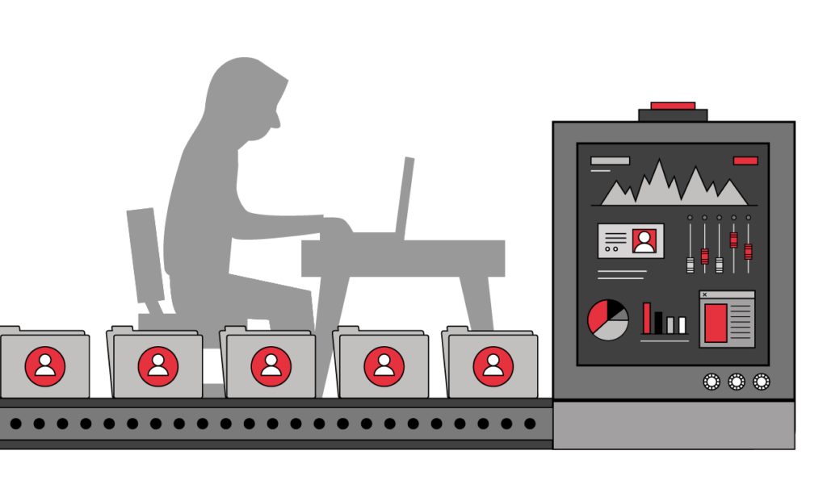
Data is bread and butter for internet companies – No absolute way to protect your data
We explore how Search engines exploit user data and use it for advertisements

Slide 4


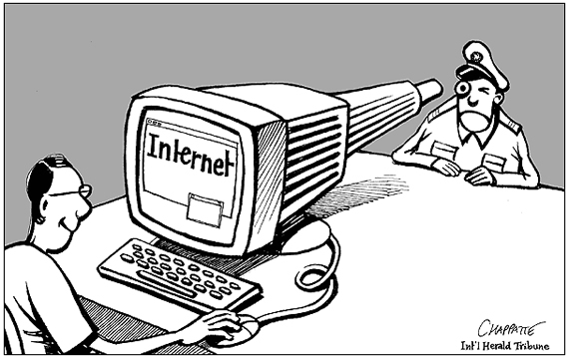
Privacy is growing concern these days
We present a tool to achieve complete privacy with search engines that try to capture data
Primary aim – Prevent search engines from profiling you

Slide 5



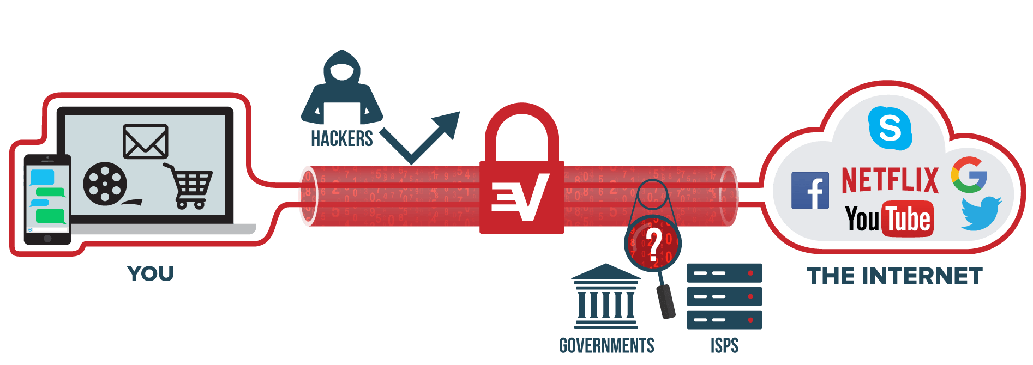
Search engines are aggressive with data capture and profiling
At user end, 3 ways to deal with data privacy -
1. Deal with causes (Prevent data capture)
2. Block outcomes of data capture
3. Share random data

Slide 6
Solution
The tool we have built combines all of these methods to some extent, to achieve anonymity
The primary data points used to profile users are
User IP (Location, browser information)
User cookies (Search history, browsing history)
Service usage history (Usage history for the particular service)
Thus, to achieve anonymity, 3 things need to be achieve:
IP masking
Cookie masking
Query masking

Slide 7

IP Masking
Hide Identity, Geography
Prevent Website Tracking
Overcome internet censorship

Slide 8
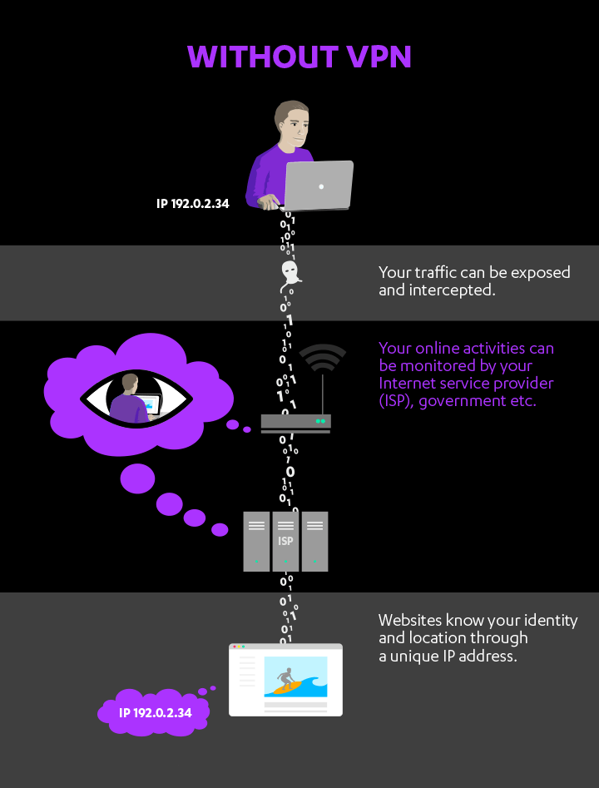
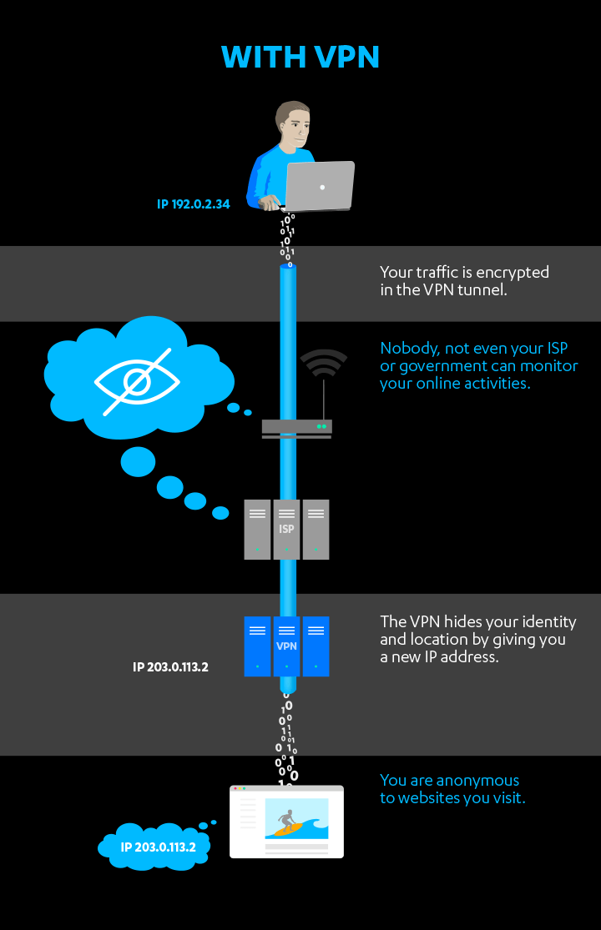

Slide 9
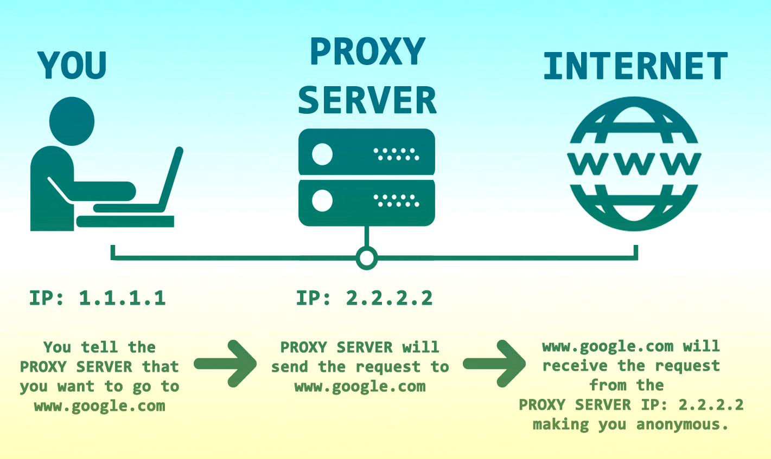
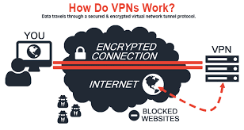
IP Masking - Approaches
VPN
-connect to a different network
-receive IP address from a VPN provider
-traffic routes from VPN network
Proxy Server
-relay your traffic back and forth through a proxy server
-Can bypass blocked sites too!

Slide 10
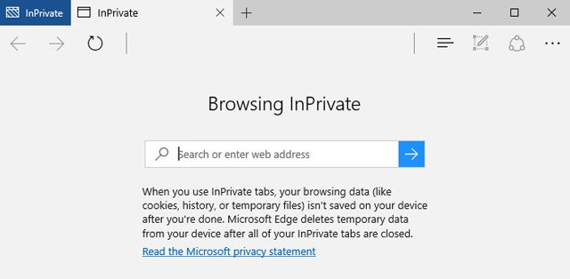
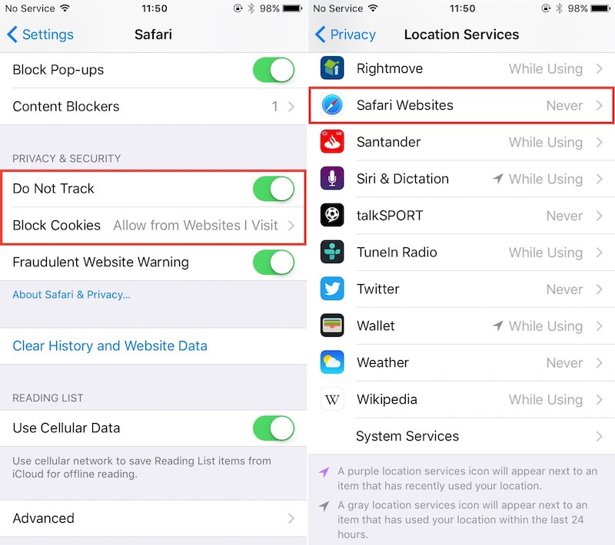
Cookie Masking
What info is exposed via cookie?
Authentication
Site preferences
Shopping cart info in shopping websites
Session tracking info
What can be done ?
-Disable third party cookies
-Private browsing mode
-Do not track header or use TPLs

Slide 11
What else need to be done as we are still not safe!
Disable Ad personalization
- Might use Google analytics browser add on to stop Google from using data to target ads.
May use tools such as Ghostery to evade tracking cookies
Might require to disable geographical sharing (default is Yes)
Root cause :
- sharing simple piece of text with the server while communication that was stored on client or some other machine
What if we can remove the header itself ?

Slide 12
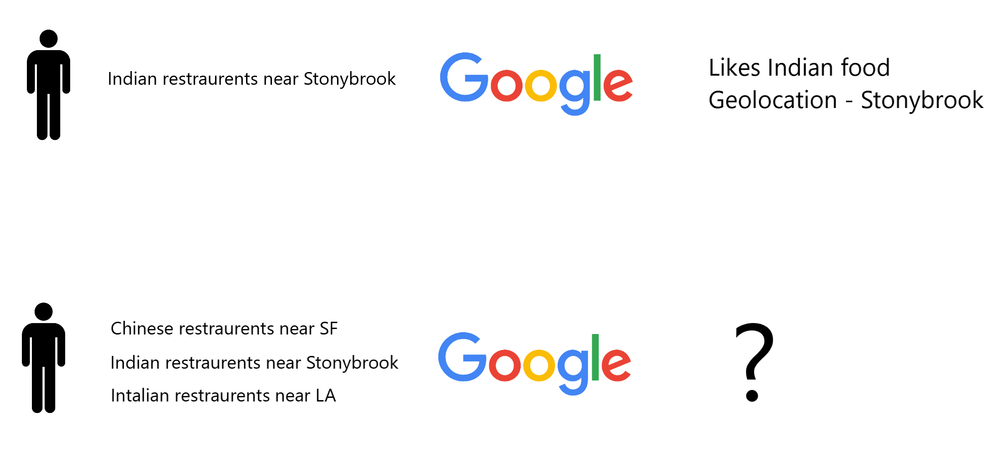
Query Masking
The search queries of the user are used to build a web profile on her.
Query masking techniques:
Confuse the search engine with other related random queries (Machine Learning)
Generate a similar query using Machine translation, hiding personal details
Notes:
Next masking we need to take care of is the query itself. This is important as these searches are used by search engine to build a web profile on the user and bother them with advertisements. The way around this, is either to confuse the engine with random queries or by generating a similar query using Machine Translation hiding personal details.

Slide 13

Machine Learning Approach
- Part-of-speech tagging is the most basic syntactic analysis we can do.
Input - A sequence of tokens (e.g., sentence, search queries)
Output - An assignment of POS tags for each word in the input.
- Using word-to-vec embeddings, replace the sensitive words with the most similar ones from the corpora.
- Thus, we can create multiple queries which are similar in semantics but are able to confuse the search engine.
Notes:
Let’s discuss the first approach, using Machine Learning. First part is to use a technique called POS tagging.It takes an input sentence and outputs the part of speech tags in it.
After we have these tags and the tokens, we use word-to-vec embeddings to replace the sensitive words with the most similar ones from the corpora.
Thus, using these similar word replacements we can create multiple queries which are similar in semantics but are enough to confuse the search engine.

Slide 14
Deep Learning Approach
- Machine translation is the process of translating a sentence from one language to another.
- Here we need to convert a search query from English to English, with similar meaning, hence needing a generalized synthesizer.
- Use a SMT approach, where translations are generated on the basis of statistical statistical models whose parameters are derived from the analysis of bilingual text corpora.
- Limitation : Same language machine translation corpora is not readily available.
Notes:
Next approach is to use Machine Translation technique which is a way to convert a sentence from one language to another.
But here, we need translation from English to English, with similar meaning and hence need a generalized synthesizer.
The way to do this, as seen in many researches in machine translation, is to use SMT, Statistical machine translation, where translations are generated on the basis of statistical statistical models whose parameters are derived from the analysis of bilingual text corpora. The only limitation with this approach is that there is not enough corpora available for same language machine translation.

Slide 15
Implementation

Slide 16
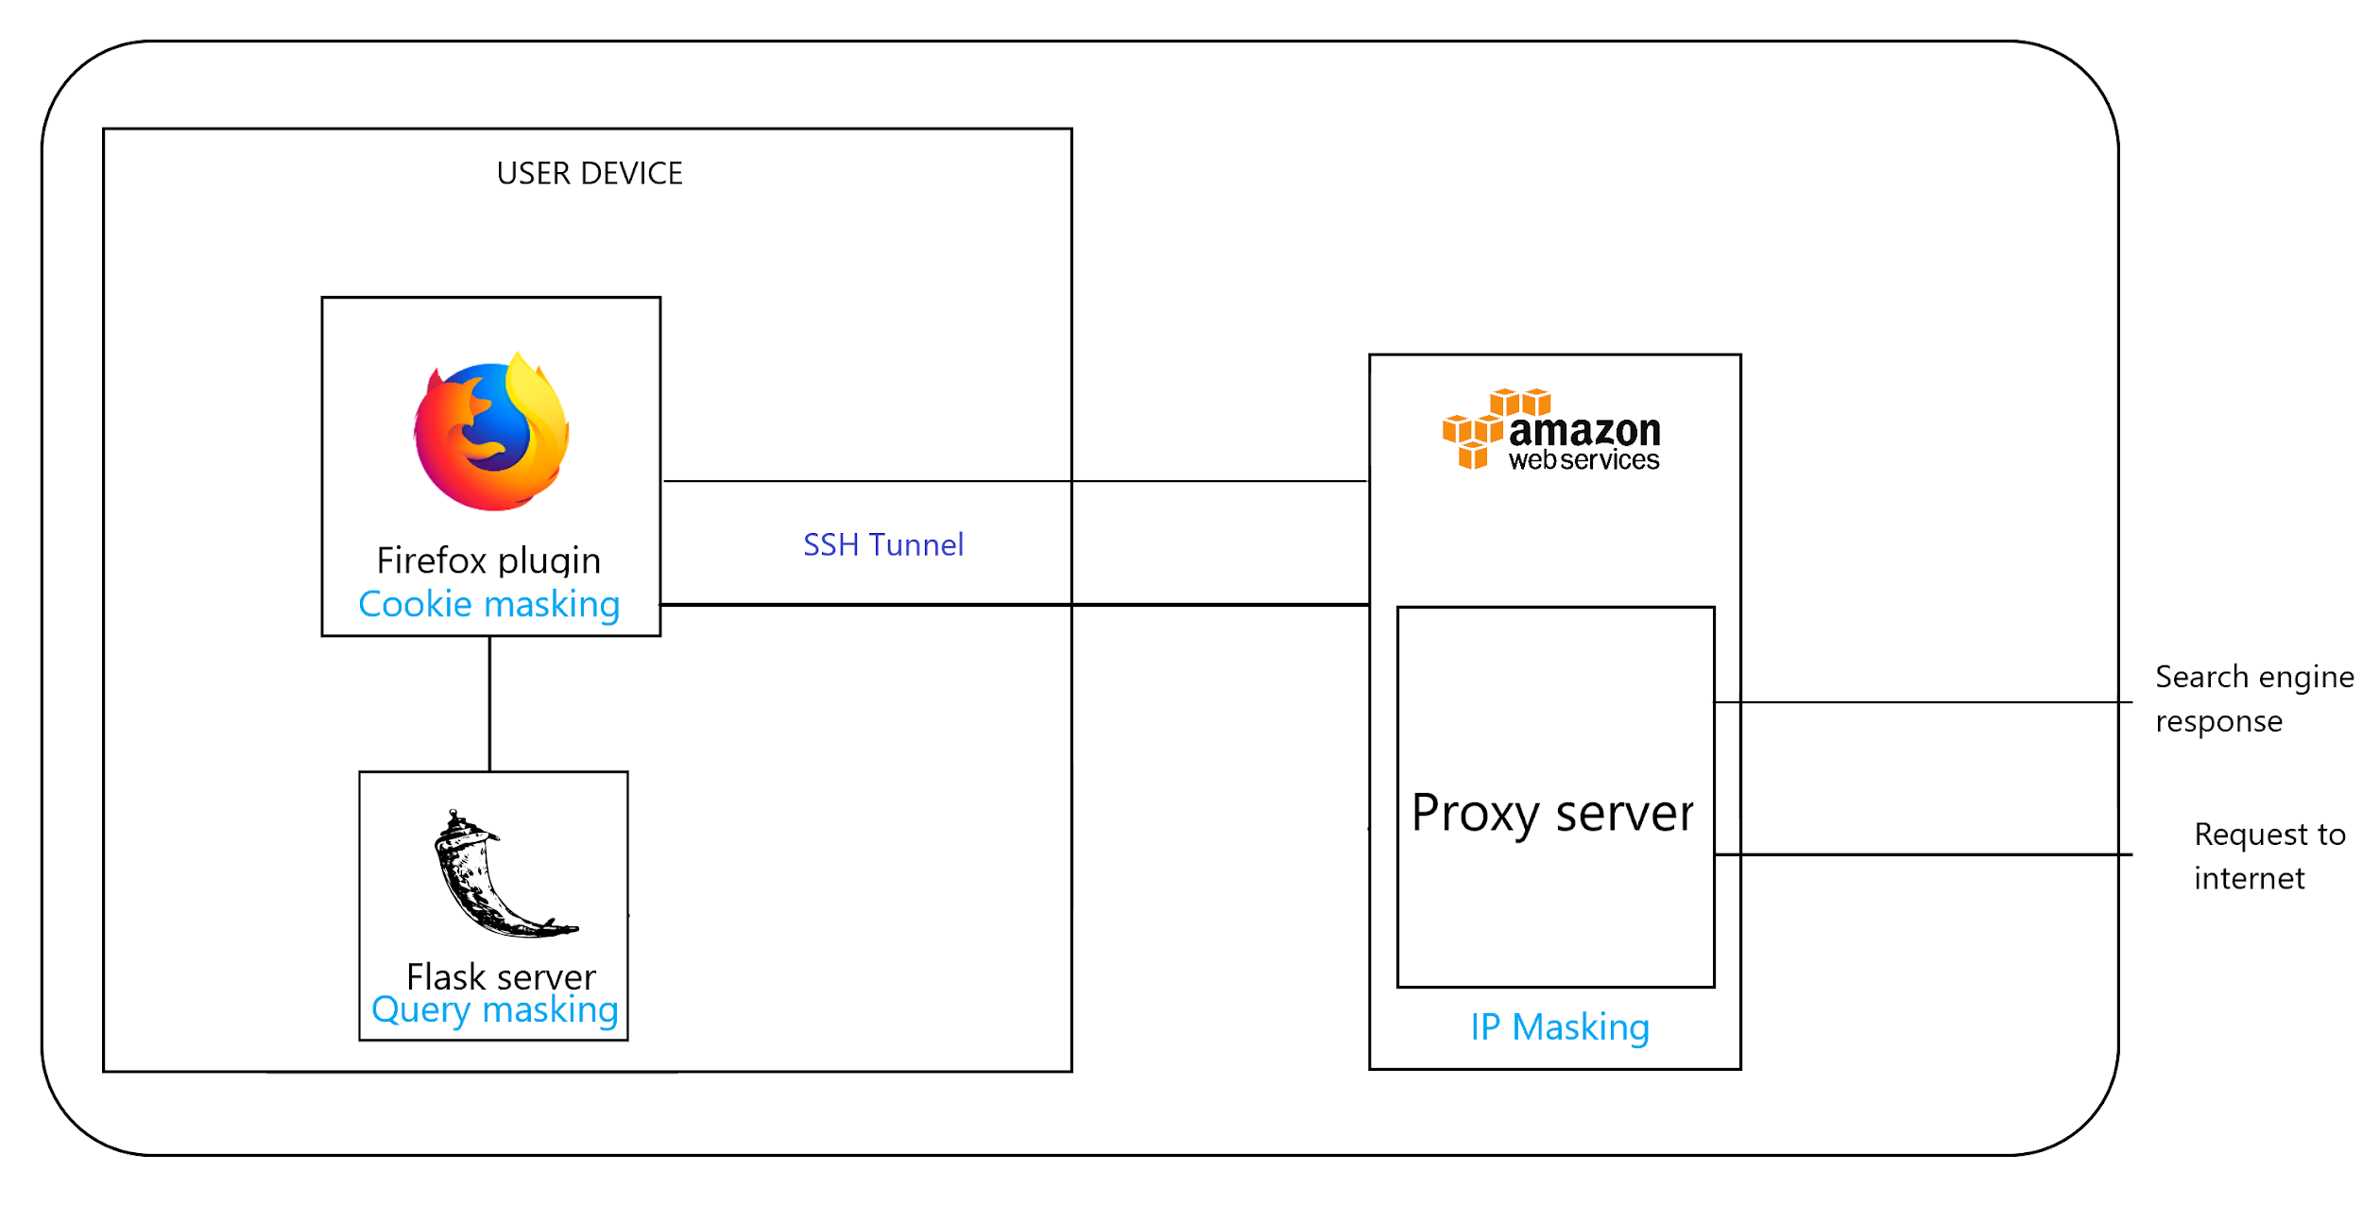
Architecture
High-level system implementation
Notes:
This is the high level system architecture of our project. It consists of three components: a Firefox plugin which handles cookies masking, a Flask server, which handles query masking, and a proxy server, running on AWS, which handles IP masking. Lets see how query masking is handled in the Flask server.

Slide 17
Query Masking Architecture
POS tagging:
Using spaCy - A free open-source library for NLP in Python. It features NER, POS tagging, dependency parsing, word vectors and more.
Word-to-vec embeddings:
Replace sensitive words like ‘Indian’, ‘today’, ‘NYC’ with words from same category.
Use gensim model : GoogleNews-vectors-negative300.bin , containing 3 million words and phrases that they trained on roughly 100 billion words from a Google News dataset.
 | Indian | restaurants | near | me | today | in | NYC
POS tagging | ADJ | NN | - | - | ADV | - | NN
NER tagging | NOPR | - | - | - | DATE | - | GPE
Notes:
For achieving POS tagging, we have used spacy, an open source NLP library in Python. IT provides two levels of tagging. The first one is part of speech tagging which tags words into Nouns, Adjectives verbs etc.
The next level of tagging, is Named-Entity-Recognition tagging, which categorises words into entities like Nationalities, Locations, Time/Date etc.
In this example, the word Indian is tagged as NOPR, which concerns with Nationalities.
We extract the words from a query which belong to such entity categories and then use word-to-vec embeddings to replace them with the most similar ones. For the embeddings we have used gensim’s GoogleNews vectors model which contains around 3 million words that are trained on Google news dataset.

Slide 18
Examples of related random queries:
Indian restaurants near me today in NYC:
- Pakistani restaurants near me tomorrow in L.A
- Italian restaurants near me yesterday in S.F.
Weather in Stony Brook:
- Weather in S.F
- Weather in Boston
Notes:
These are some of the examples. Here we extract the words “Indian”, “Today” and “NYC” and replace them with most similar words. Indian is replaced by Pakistani or Italian, today is replaced by tomorrow or yesterday, NYC is replaced by LA or SF.

Slide 19
IP Masking & Cookie Masking
Client machine sets up a SSH tunnel with a set of Amazon cloud EC2 instances
Mozilla Plugin selects a proxy out of the set in a round robin fashion to send out web search queries
Uses the proxy as a SOCKS5 host
Port forwarding used to forward traffic to the EC2 instance selected via the tunnel
The search query intercepted by the Mozilla plugin
- It adds the cookie policy to reject all cookies sent by the server

Slide 20
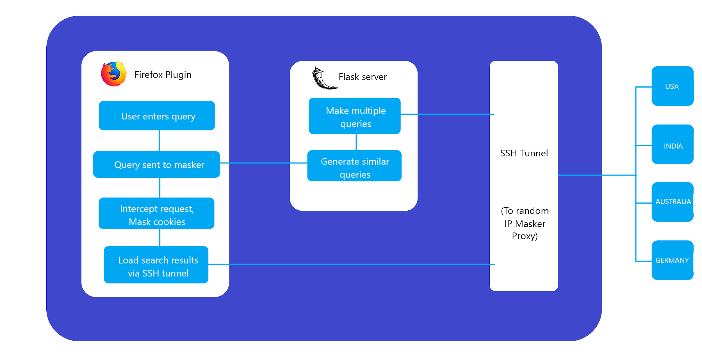
Execution of Search
What happens with every search query

Slide 21
Thank you!

